Slide 1
Software Documentation
Chapter One
Understanding Task Orientation

Slide 2
Software Documentation
Def:
Is a form of writing for both print and online media that supports the efficient and effective use of software in its intended environment.
Software Documentation Forms:
Print User’s Manual
Installation Guide to the online help program
Wizards
Tutorials
“getting started” booklets

Slide 3
Importance of Software Documentation
It help software users learn program features and use them to work productivity.
It contributes significantly to the value of the software product.
It contributes to the users efficiency in the work place.
It aims to supporting experts ,guiding and teaching beginning and intermediate users.

Slide 4
Writing software documentation Guidelines
Understanding task Orientation.
The Forms of Software Documentation:
Writing to Teach (Tutorial).
Writing to Guide (Procedures).
Writing to Support (References).

Slide 5
Writing software documentation Guidelines
The Process of Software Documentation:
Analyzing your Users.
Planning and writing your document.
Getting useful reviews.
Conducting usability tests.
Editing and Fine tuning .
The tools of Software Documentation :
Using Graphics.
Getting the Language Right.
Layout pages and screen.
Designing Indexes.

Slide 6
Understanding Task Orientation
Def:
Is an approach to software documentation that present information in chronological order based on the user’s workplace sequence .
It encourages the successful application of software to workplace objectives.

Slide 7
Understanding Task Orientation
Understanding task Orientation helps Software Documentation writers to achieve two goals:
Encourage the users to learn the program (Proficiency)
Encourage the users to apply the program to problem in the workplace (Efficiency)
It adapt the software to the user’s job, rather than making the user adapt to the software.
It make the software usable.

Slide 8
Task-oriented Documentation
When we describe a manual as “ task oriented” this mean:
It helps the user to manage and communicate information related to his or her task.
Users can clearly see the relation between new program and their work place.
Task-orientated documentation consists of manuals and help that reflect real users and human forms.
The process of task-orientated documentation requires that you analyze the user in his or her work environment to discover the rich texture of activities within the software program and where the manual fits.

Slide 9
Guidelines for Successful Software Manual
1. Emphasize problem solving:
A manual should help users solve problems in their workplace.
You can help the user through introductory paragraphs that preview not only the steps to follow, but the goals and objectives of their software work.
Example:

Slide 10
Guidelines for Successful Software Manual
2. Provide Task-Oriented Organization:
Organize a manual or help system in a way that matches the kinds of tasks a user will perform.
Example:
A word processing manual that follows the “ open a file, type in words, save the file, exit the program “. The sequence would seem more logical than one organized alphabetically.
A task oriented arrangement should be spread all over the design of your manual from the table of the content ( of your manual) or the introductory screen ( of your help system ).

Slide 11
Guidelines for Successful Software Manual
3. Encourage user control of Information
This mean the feeling , among software users, that they decide what the program does for them.
So, the manual should show users how to make key decisions, supply key information, or determine key program outputs.
Cross references in manual and hypertext links in online system can help maintain the user’s sense of control over the documentation , because these document design elements allow users to choose where they go for additional information ,or where to proceed after they have finished a section.

Slide 12
Guidelines for Successful Software Manual
4. Orient pages Semantically:
Semantic Orientation in page design means you arrange the elements of the page meaningfully according to elements of the job the user needs to perform.
Example:
Putting important elements first and making important elements larger to help user apply the program to their work.
Employs visuals and graphic to text in a complementary way.

Slide 13
Guidelines for Successful Software Manual
5. Facilitate Routine and Complex tasks
Users of software face two types of task :
1. Routine Task:
Repeatable tasks that are easily represented by conventional procedures .
Example:
Save a file, print a file , open , and so on.
2. Complex task
Require the user to apply knowledge that is not easily codified in step by step procedure, it comes from years of experience.
Example:
Using a word processor to identify trends in annual reports .
The more you can help users apply software to complex tasks the more users will value your manual or help system .

Slide 14
Guidelines for Successful Software Manual
6. Design for Users:
User driven design means manual comes from the user needs rather than from models or templates of what a user guide should look like.
User driven design should allow users to :
Find what they need.
Understand what they find.
Use what they understand appropriately.

Slide 15
Guidelines for Successful Software Manual
7. Facilitate Communication Tasks:
Users of software programs work in context that require them to communicate about their work.
Communication tasks depend on the user’s workplace demands rather than on a narrow view of program features.
Document designer should know what kind of information users communicate and to whom and help them achieving this.
Document designer can help the user see the why behind the program features by analyzing what kind of info user needs and how they communicate.
Communication tasks are facilitated by tasks that transfer data from one application to another .

Slide 16
Guidelines for Successful Software Manual
8. Encourage user Communities
Task oriented manuals encourages users to identify and get helps from others. Some software has some features that encourage group or team work.
Other users of the program ,while not exactly experts in the software ,can render valuable help because they understand the user’s job demands.
User communities can help provide candidates for this kind of user-involved document development.

Slide 17
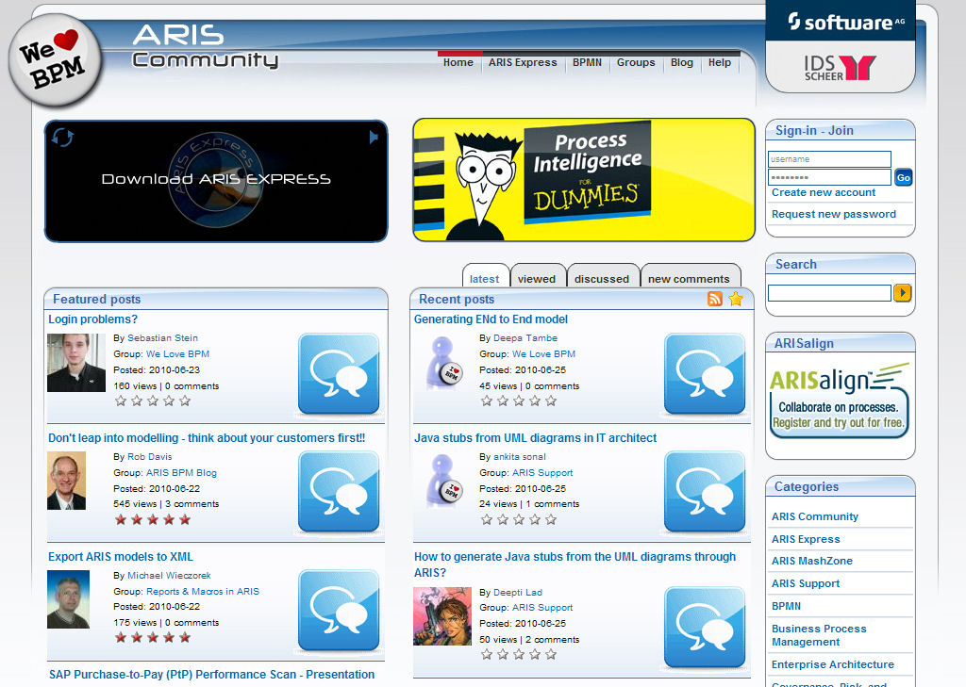
Guidelines for Successful Software Manual
8. Encourage user Communities

Slide 18
Guidelines for Successful Software Manual
9. Support Cognitive Processing
People always use mental model –cognitive schema-, that help them learn, process, and apply the information.
Task oriented manuals uses principles of knowledge representation, parallelism and analogies to convey software features to workplace.
These techniques (analogies and parallelism) allow user to absorb what manual has to say with as little effort as possible.

Slide 19
Guidelines for Successful Software Manual
The good manual or help system has many features that make it succeed ,
But
The more a manual can support productive work, the greater the chance of acceptance and satisfaction by a user.

Slide 20
Goals of the Software User and Manual
Goals of the user: 1- Learn how to use the program. 2- Apply the program to useful work.
Goals of Manuals or Help screens: 1- Support the features of the program. 2- Tell how to apply the program to the user’s job.

Slide 21
Task Orientation
Def:
A design strategy for software documentation that attempts to increase user knowledge of and application of a program by integrating the software with the user’s work environment.

Slide 22
Task Orientation
When a user sees that learning and using a program can increase job efficiency ,most will take time to read the manual and read the program.
The full potential of a manual is realized when technical writers take an approach to develop documentation( online and on paper) that models the natural cognitive processes of users who are seeking to fill knowledge gaps through the right information ,presented at the right time ,and in the right place to meet task goals.

Slide 23
Software User Types
User :
Is a person who operates a computer.
There are two ways to define the user of any software:
1. The Default User:
a person who needs to learn about menu functions and commands.
An operator instead of thinker.
2. The Task-Oriented User:
A person who uses software for workplace ends.

Slide 24
The default User Characteristics
1. Decreased importance of job skills,
“My experience isn’t good any more.”
Job deskilling: which means that the computer program can perform many of the tasks a person used to perform, so the job required less skilled people .
The default user is the user who “ lets the computer do it “
Increasingly abstract tasks,
“ I just can’t understand how this thing works. “
People have trouble seeing the link between doing by hand and doing with a computer lies to the abstract nature of computer work.
Feeling of loss of control over their work, user feels that it loses most of its simplicity.

Slide 25
The default User Characteristics
3. Increasingly isolated from other employees, “I’m stuck in front this computer. “
People need others to communicate with, to get feedback from, and to get rewards that make work enjoyable.
4. Remotely supervised, “My boss has an electronic leash on me.”
The default user feel increasingly exposed to the manager.
They may lose their sense of control over their work, because of the increased supervision exercised through computer system.

Slide 26
The default User Characteristics
5. Overloaded with information, “why do I need to know that?, information anxiety.”
They resist computer use because they feel overloaded by information.
Having too much information without the ability to understand its significance can cause information anxiety.
This causes many users to restrict their use of software and give up trying to learn and apply it .

Slide 27
The Task-Oriented User Characteristics
1. Challenged by skill demands: “This program makes me a better user “
Require user to engage in complex tasks, that require human mind and sophisticated knowledge.
Computer can sort and categorize ,but it can’t handle ideas.
The manual must points the user in the right direction.
Computer activities (using word processor) require actions (writing a letter) and operations (opening a file, setting a margin, checking spelling, selecting a font..).
The task-oriented manual instructs to action level ,rather than the operation level.

Slide 28
The Task-Oriented User Characteristics
2. Conceptually Oriented
“ This gives me something new to think about “
Difficulties when using computer that you have to learn more than your actual work. (For example you have to learn internet security, encryptions… etc when you use a billing application program).
This information is called Tacit knowledge, because it is not easily represented by steps.

Slide 29
The Task-Oriented User Characteristics
3. Aware of user communities:
“ For those user using the same program. “
User groups: refers to groups that meet, electronically or in person, to discuss issues related to their job activities.
Allow users to increase their social contacts within an organization and overcome the sense of isolation they may feel.

Slide 30
The Task-Oriented User Characteristics
4. Information Rich : “ My software help me sort out my work.”
Good software documenters should find ways to reinforce workplace skills by showing users the potential use for information that programs generate.
It can open users up to a new kind of tasks.

Slide 31
User Types
1. Novice Users:
Initial users of a program ,or novice users of software in general.
Require tutorial documents, the intension of which is to teach basic functions and their applications.
2. Intermediate Users:
Require procedural documentation.
The intension of which is to help them during actual use of the program in their workplace.

Slide 32
User Types
3. Advanced Users:
Require Reference documentation .
The intension of which is to further their understanding about how the program operates and how they can manipulate and adapt it to highly specialized uses.

Slide 33
The Forms of Software documentation
Tutorial Documentation:
Intends to teach a basic functions and features of a program to a user .
The user motivation is to learn.
The relationship between the writer and the user resembles that of a teacher and learner.
Define the tasks through : sample scenarios, examples of usage, demonstrations, etc .
Focus on basic actions that the user can take.

Slide 34
The Forms of Software documentation
Procedural Documentation:
Intends to guide the user step-by-step procedures for using the program(often when the user needs information at the time of use).
The user motivation is perform action tasks.
The relationship between the writer and the user resembles that of a guide and mentor.
Define the tasks through : tips and help embedded in the user interface, context-sensitive help available at the click of the mouse, wizards that assist users in performing difficulties .
Focus on operations organized around workplace actions.
Employs many tools to help users in actual use of the program ,including step-by-step procedures, suggestions and tips and descriptions of fields .

Slide 35
The Forms of Software documentation
References Documentation:
The user motivation is to obtain information “about” the program for advanced user.
The relationship between the writer and the user resembles that of a resource and client.
Lets the user define the task.
Focus on the descriptive of the program itself than of the user or the user’s application of the program.
Example: alphabetical listings of program features, lists of examples, file formats, technical troubleshooting data and special program settings.

